Slide 1
Welcome
to the
9th Annual
International Systems Conference
Sponsored by
IEEE Systems Council

Slide 2
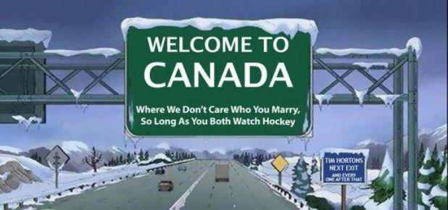

Slide 3
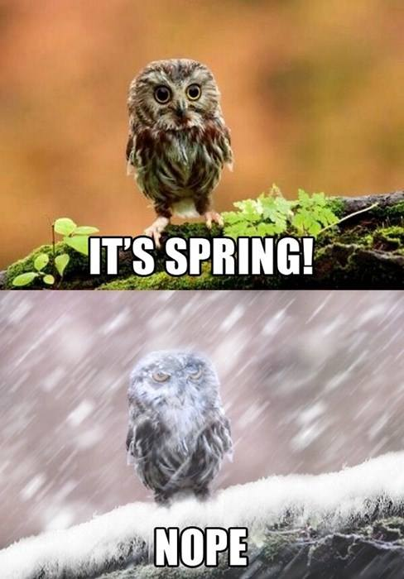

Slide 4
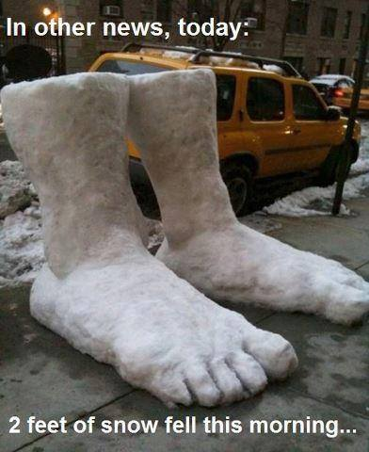

Slide 6
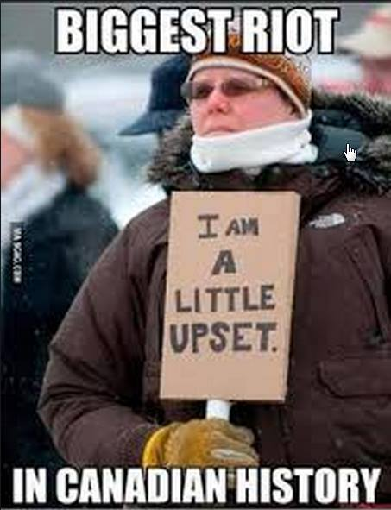

Slide 7
Why Are We here?
Systems Engineering is a discipline needed in almost every environment and application
Commercial products
Infrastructure such as energy, transportation, etc
Health care
Defense systems
Information technology
Communication systems
etc
Why?
It is the overarching engineering “glue” that views the “system” as a whole – looking at all the components and elements—intended use---maintenance---human interface---safety---environment---
- - - and complex, systems-of-systems are becoming more the norm than the exception

Slide 8
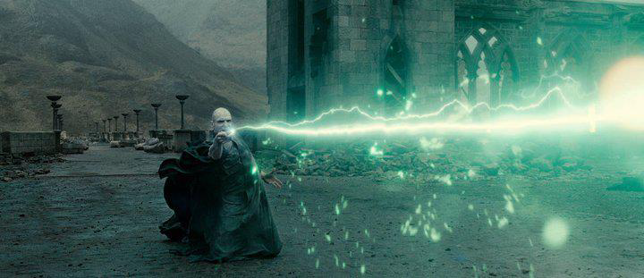
Systems Engineering is no magic wand - - -

Slide 9
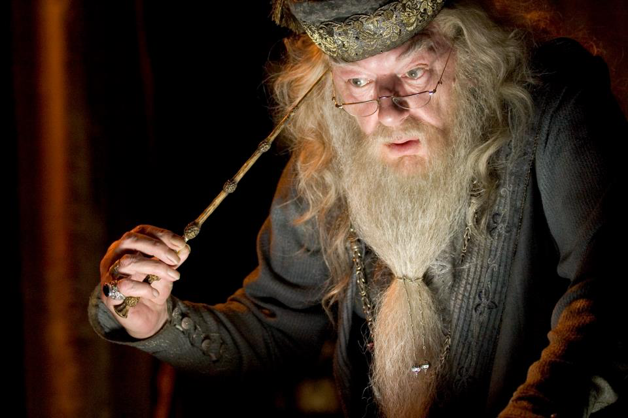

Slide 11
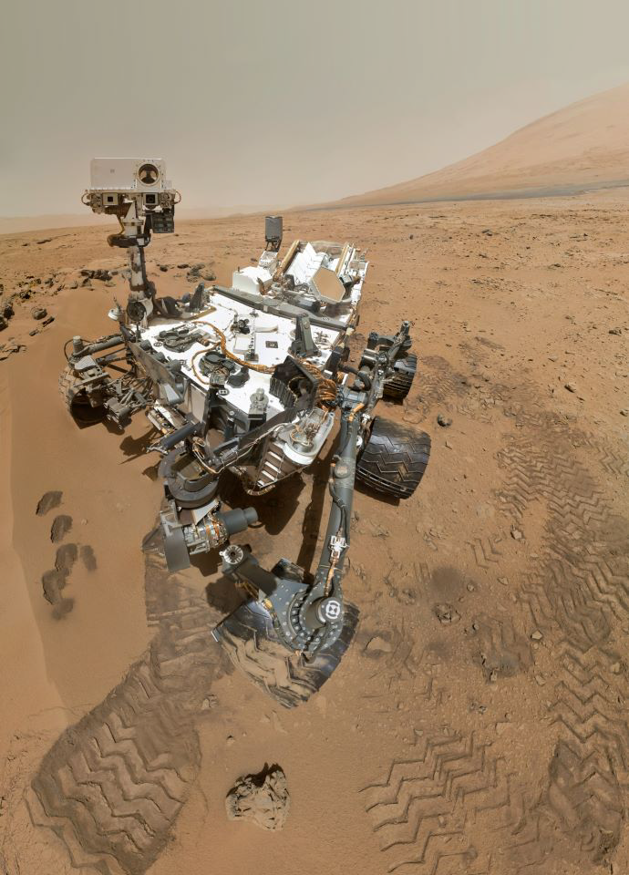

Slide 12
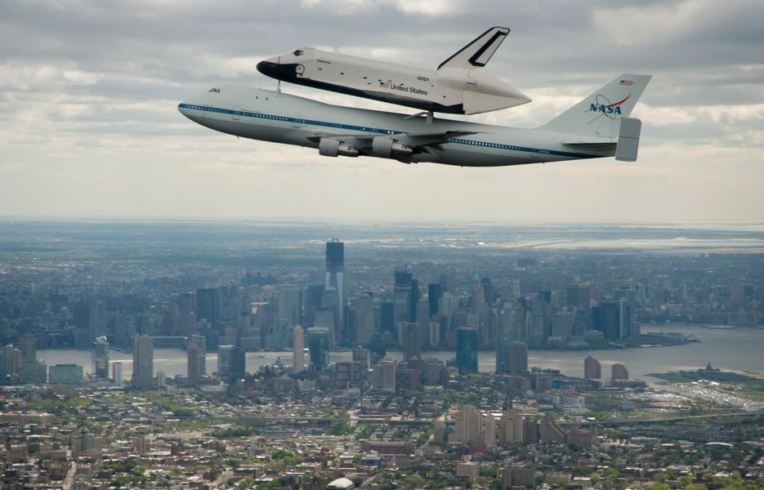

Slide 14
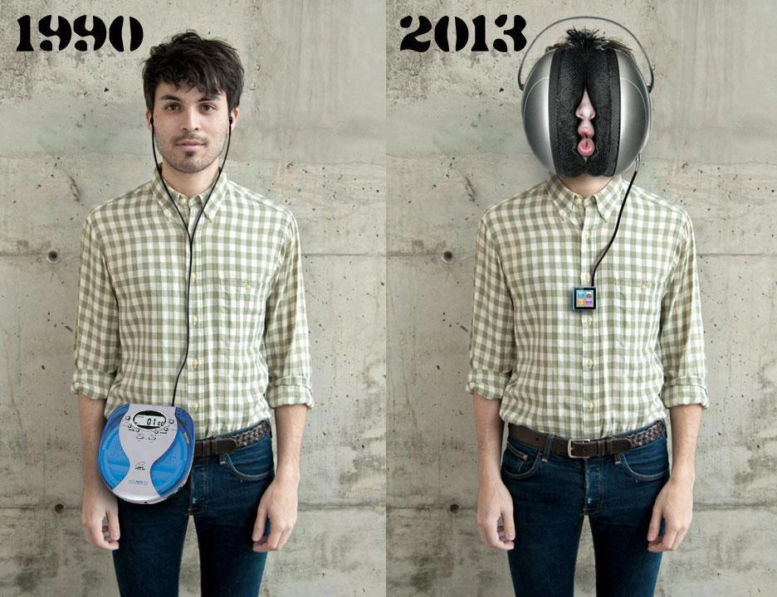

Slide 15
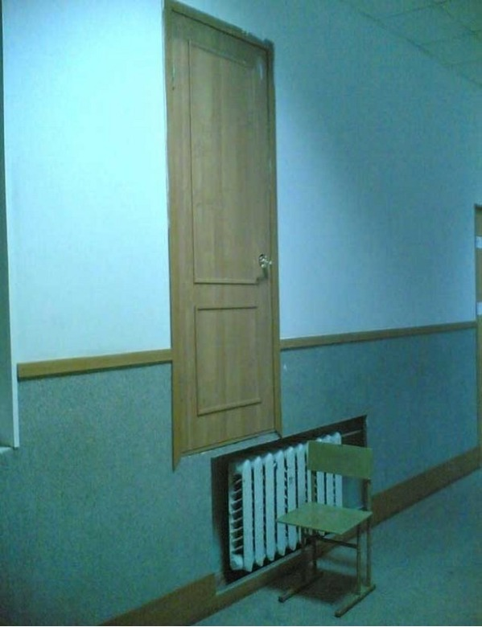

Slide 16
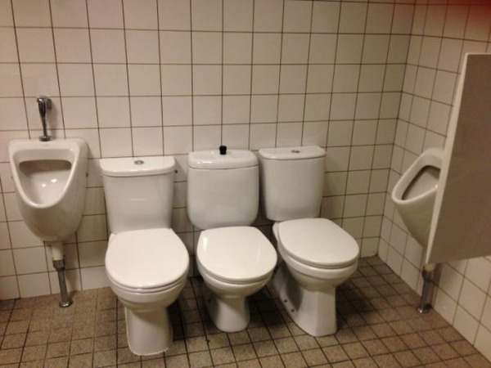

Slide 17
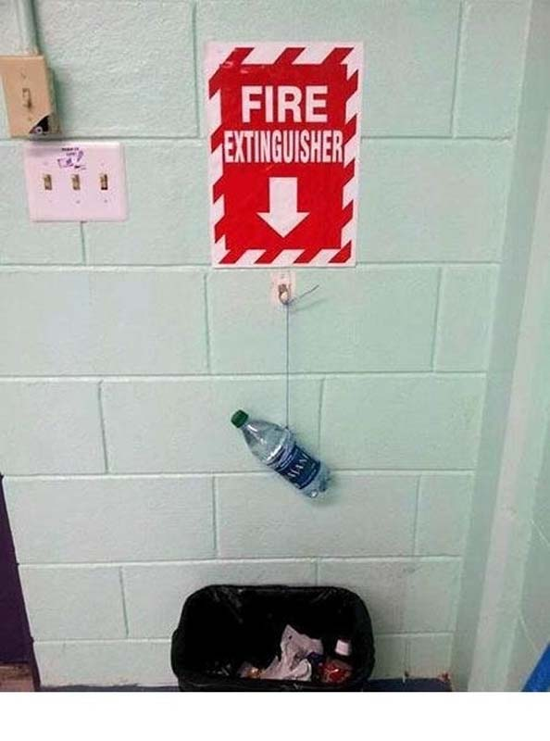

Slide 19
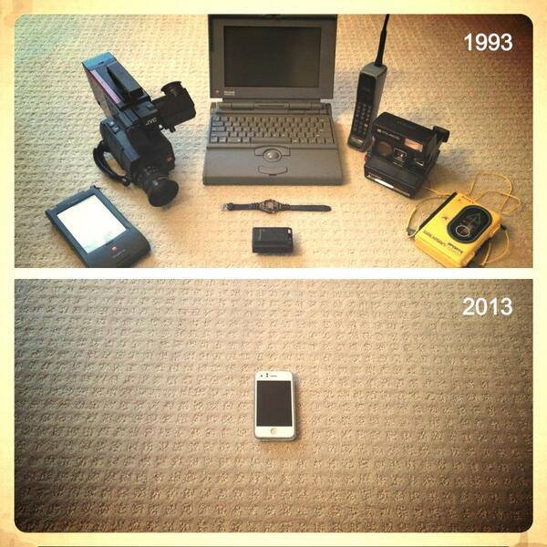

Slide 20
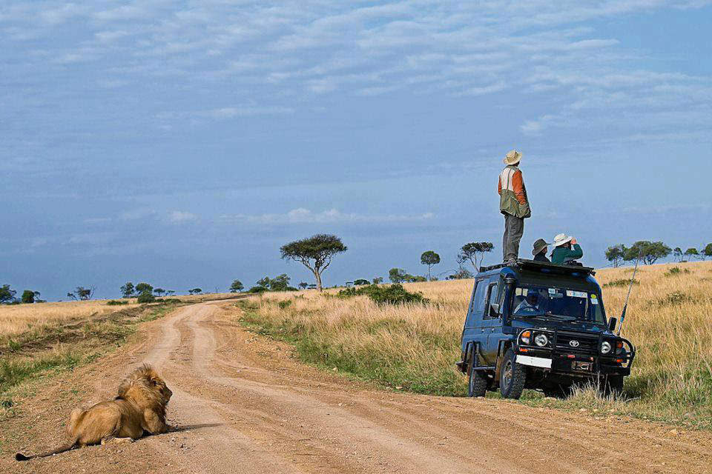

Slide 21
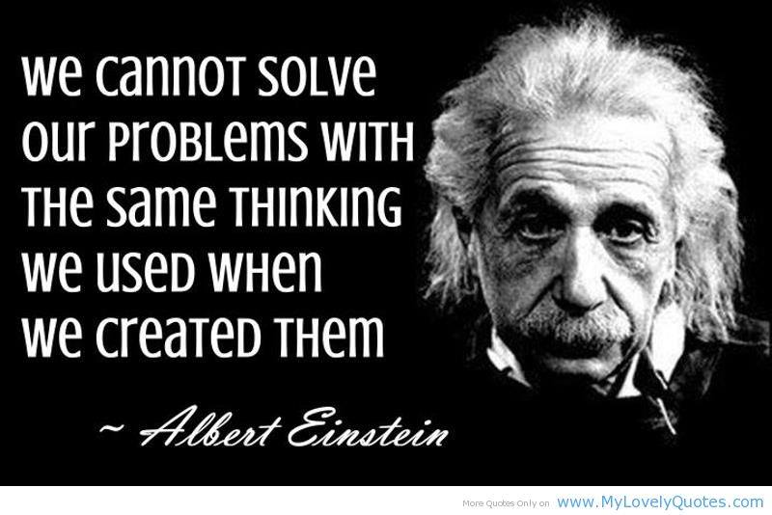

Slide 22
Agenda: Tuesday April 16
8:15 Intro & Welcome Bob Rassa
Director, Engineering Programs, Raytheon SAS
8:30 Keynote Col. Robert Lyons (USAF, Ret.)
President, IEEE Aerospace & Electronic Systems Society and former Director, USAF AFMC Command Acquisition Center of Excellence
9:30 Break
10:00 Executive Panel “Systems Engineering Body of Knowledge”
Dick Fairley, IEEE Computer Society
Art Pyster, Stevens Institute of Technology
Rick Adcock, Cranfield University
David Olwell, Naval Postgraduate School
Garry Roedler, Lockheed Martin
12n Lunch in Pinnacle III Luncheon Keynote
Chris Paredis, Program Director, ENG/CMMI Engineering & Systems Design & Systems Science Programs, National Science Foundation
1:30 Technical Breakout Sessions begin:
See Program for details
6:00 – 7:30 “Heavy” Reception, Exhibits Prefunction Area

Slide 23
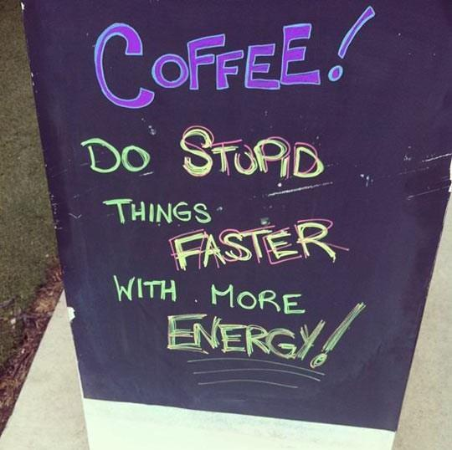
Some Logistics Info---
Coffee Breaks are in
Prefunction area
Detail Program schedule
is in the conference program
Lunch is in Pinnacle III, Tuesday and Wednesday
Wednesday is Awards Lunch for Best papers

Slide 24
Conference Administration
For conference assistance/questions, please contact Registration Desk
Cell phones & Blackberries OFF in meeting rooms
Potential interference with conference audio, plus it annoys your neighbor when the phone rings
WiFi: Marriott Conference “IEEE3”
IEEE Systems Journal
Authors wishing to have their conference paper accepted for publication in the IEEE Systems Journal may submit an extended abstract to the Journal editorial staff.
http://www.ieeesystemscouncil.org/
Dr. Vincenzo Piuri, editor-in-Chief and IEEE Vice-President, Technical Activities

Slide 25
Special Thanks to…
Dr. Sidney Givigi, Royal Military College, Kingston ONT Canada; Technical Program Chairs
Technical Program Committee
For their hard work over the past year
Conference Catalysts LLC
Mr. Chris Dyer, Ms. Cynda Covert
For exceptional conference management
Tutorial Instructors
Bob Schwarz, WPI;
Yvette Rodriguez, DAU;
Shrisha Rao, IIIT;
Nader Mehravari, SEI/CMU
Exhibitor
Urban Aboriginal Fair Trade Gallery

Slide 26
Attendee Demographics
192 attendees, 31 tutorial attendees
Australia - 6
Austria - 2
Brazil - 4
Canada - 19
China - 6
Estonia - 2
Finland - 2
France - 10
Germany - 19
Ghana - 3
India - 4
Israel - 7
Italy - 2
Japan - 1
Kenya – 1
South Korea - 1
Kuwait- 1
Netherlands - 3
New Zealand - 1
Norway - 3
Saudia Arabia- 4
Slovenia - 1
Spain - 1
Sweden - 2
Taiwan - 1
Thailand - 1
Turkey - 2
UAE - 1
UK - 7
USA - 79

Slide 27
Breakout Session Tracks starting Tuesday 1:30 pm
Cyber Security Pinnacle I
Complex Systems Pinnacle II
Research in Systems Engineering Shaughnessy I
Model-based Systems Engineering Shaughnessy II
Systems Verification/Validation Dundarave
And starting at 3:30-
Modeling Simulation Pinnacle I
Decision-making Systems Shaughnessy I
Medical Systems Dundarave

Slide 28
And Announcing--
10th Annual
International Systems Conference
April 18 - 21, 2016
Hyatt Grand Cypress Hotel
Orlando, Florida

Slide 29
Also Announcing--
1st Annual
International Systems Symposium
September 29-30, 2015
Marriott Airport Park
Rome, Italy

